Slide 1

Capstone Project: Northwind Sales Analytics
Power BI | SQL | Excel Project

Slide 2
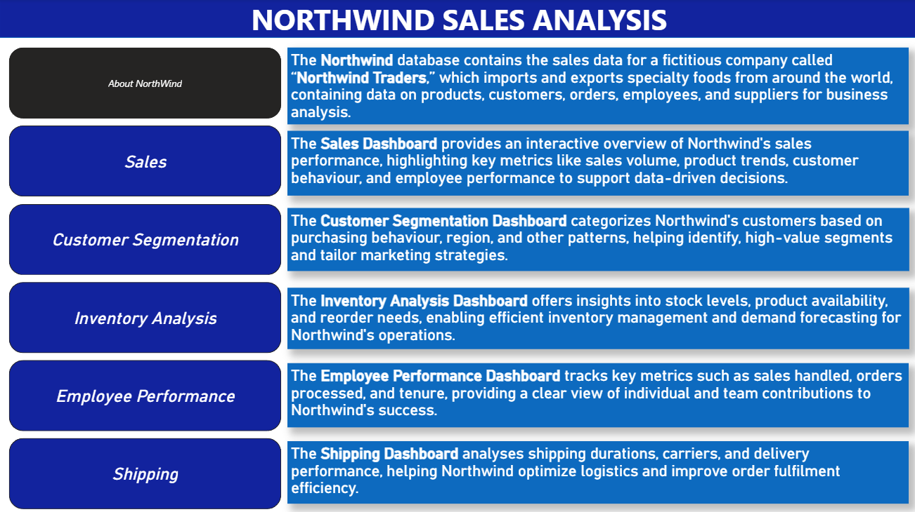

Slide 3




Objective: The objective of this project is to create an end-to-end data analytics solution using the Northwind database. By leveraging SQL for data extraction, Excel for exploratory data analysis, and Power BI for dashboarding, the project uncovers insights into customer behavior, sales trends, inventory management, employee performance, and supplier distribution. These insights aim to support data-driven decision-making and strategic planning.
Analysis Scope: The analysis covers key aspects of Northwind’s operations, including customer segmentation, regional order patterns, sales by product category, inventory stock health, employee workload, and shipping efficiency. Historical transactional data is modeled to provide a comprehensive view of the company’s business processes and to highlight critical patterns and dependencies.
Goal: The goal of this project is to deliver an interactive analytics framework that offers a holistic view of the company’s performance. It provides actionable insights to improve customer retention, optimize inventory levels, monitor employee productivity, and strengthen supply chain operations, thereby enabling better planning and sustainable business growth.

Slide 4

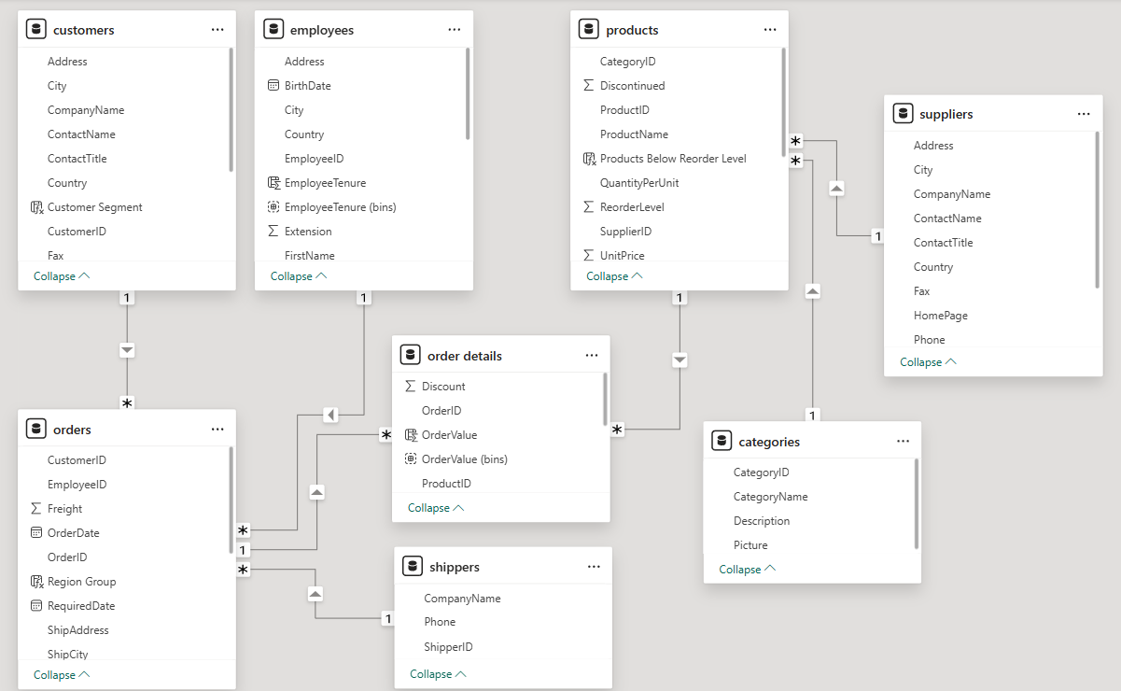
ER Diagram

Slide 5
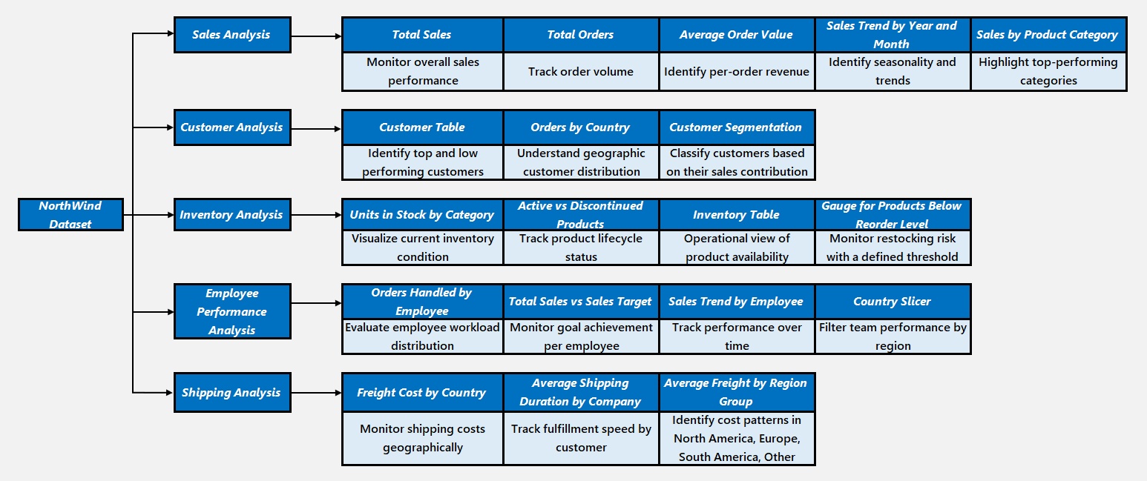
MECE Breakdown

Slide 6
Power BI Dashboard

Slide 7
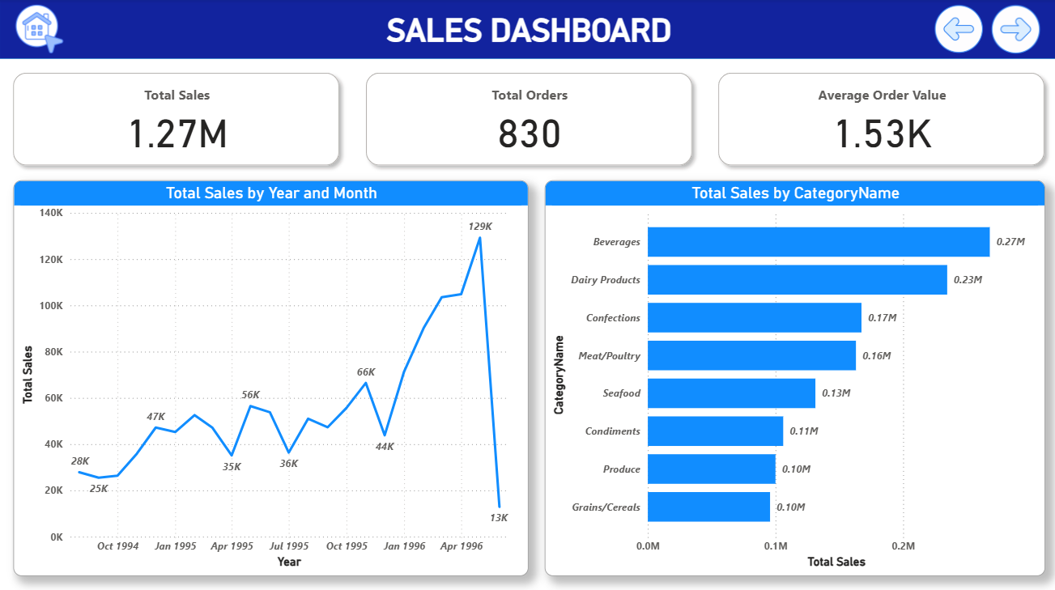

Slide 8

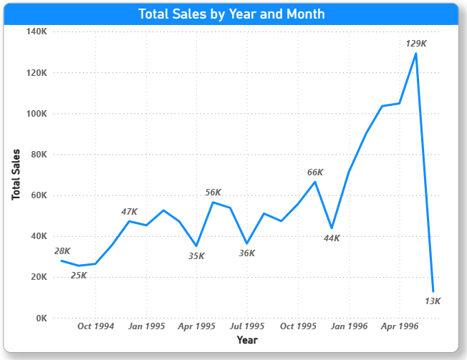
Problem Statement: How has sales performance changed over time?
Analysis:
The line chart of sales by year and month show clear seasonality and growth trends.
Peaks in certain months highlight periods of high customer demand.
The year-on-year growth pattern provides insights into long-term business expansion.
This trend analysis supports strategic planning, inventory stocking, and forecasting.

Slide 9
Exploratory Data Analysis (EDA)

Slide 10
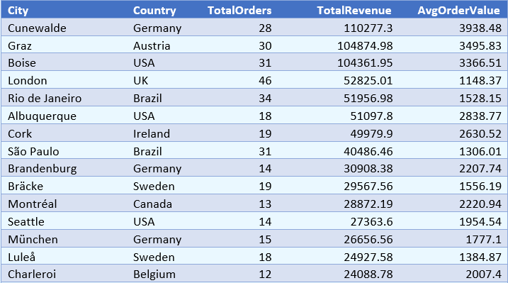
Problem Statement: How do customer order patterns vary by city or country?
Result Table:
Analysis:
Order behaviour differs by region. Cities like Cunewalde (Germany) and Boise (USA) show higher revenue per order, while cities like London (UK) generate more frequent but lower-value orders.

Slide 11
Key Insights
Customer segmentation revealed that high-value customers place 3x more orders compared to low-value customers.
Beverages, Dairy Products, and Confections are the top-performing product categories.
Several products are below reorder level, indicating a need for proactive restocking.
Orders are unevenly distributed across employees, with a few handling significantly more workload.
France and Germany dominate supplier distribution, often offering higher-priced products.

Slide 12

Thank You

